Slide 1
Java Updates 1.7

Slide 2
Version Control and Revision History
 | Name | Date
Prepared By
Reviewed By
Approved By
Version No. | Date | Affected Sections | Highlights

Slide 3








Iconic Representations.......
Test your Memory
Can you Solve?
Objective
Coffee Break
Queries
Recap
Need more Info
Brainstorm

Slide 4
Objectives
To understand the updates of JDK 1.7 version.
Java 7.0 came up with a number of new features including the Diamond operator in Generics
Strings in switch statement
Multi catch exception handling
Underscores in numeric literals

Slide 5
Contents
Strings in switch statement
Try with resource statement
Multiple Exception catching
Underscores in Numeric Literals
Diamond Operator

Slide 6
Strings in switch statement
Prior to Java 7 the condition code in a switch statement had to be a Integer type (long types are not allowed) or enum values.
Java 7 allows programs to switch on a string.
The switch statement compares the passed string with each case label and execute the case block which have matched string.
The comparison of string in switch statement is case sensitive.
Example code is given in the next slide.

Slide 7
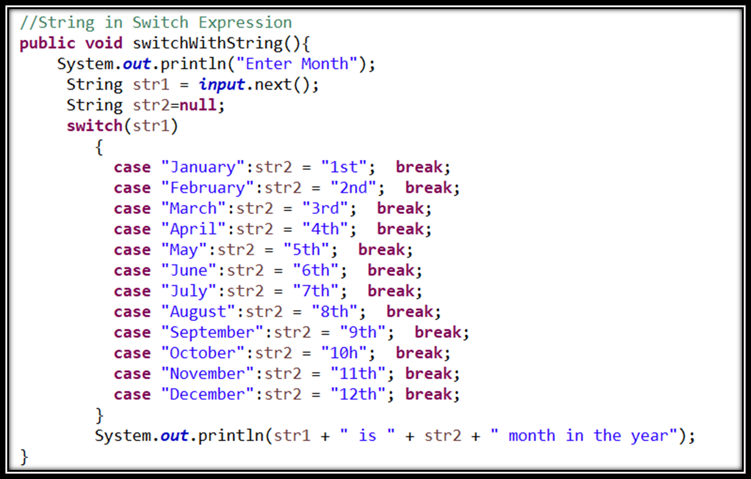
Strings in switch statement

Slide 8
Try with resource statement
It is also known as Automatic Resource Management(ARM).
The try with resource statement contains declaration of one or more resources.
Prior to Java SE 7 resource object must be closed explicitly, when the resource use or work is finished.
After the release of Java SE 7 the try with resource statement handles it implicitly means it automatically closed the resource when it has no longer use to the class.
Example code is given the next slide.

Slide 9
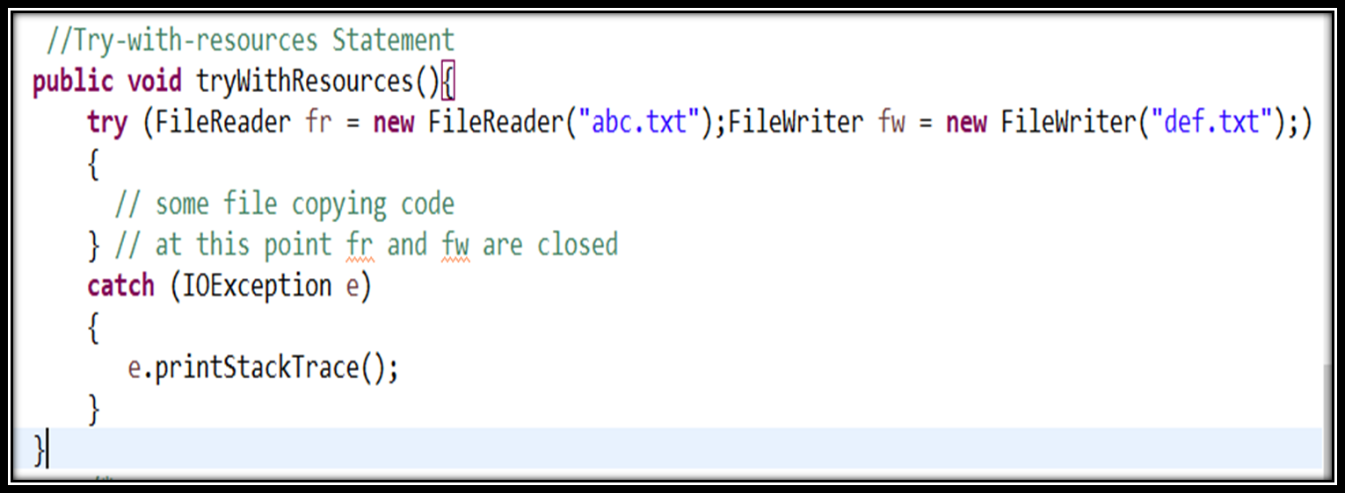
Try with resource statement

Slide 10
Multiple Exception Catching
Java 7 introduced multi-catch functionality to catch multiple exception types using a single catch block.
In the pre Java 7 world, you would handle exceptions by writing separate catch blocks for different types of exceptions that occur in the try block.
Java 7 multi catch block provides you the flexibility to combine such catch blocks provided you have similar code to handle these exceptions.
Example code is given the next slide.

Slide 11
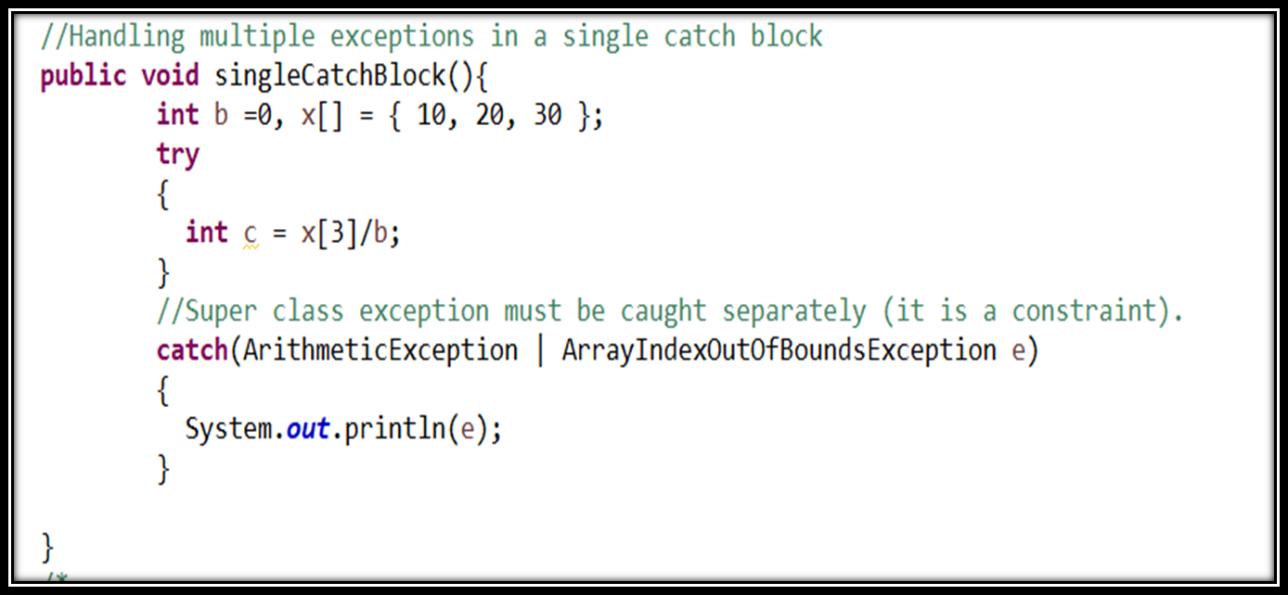
Multiple Exception Catching

Slide 12
Underscores in Numeric Literals
Declaring numeric literals with underscores would have caused a compile error in any previous release of the language.
But in Java 7 numeric literals with underscore characters are allowed.
You can place any number of underscore(_) between digits of numeric literals.
This added feature improves the readability of the code.
For Example credit card number can be write as follows:
Long creditCardNumber=1234_5678_9012_3456L;

Slide 13
Underscores in Numeric Literals
You can place underscore between digits. But for placing underscore you need to be careful.
You can’t place underscore in the following places:
You can’t place it at the beginning or at the end of a number.
Adjacent to a decimal point in a floating point literal.
Before to an F or L suffix.
In positions where a string of digits is expected.

Slide 14
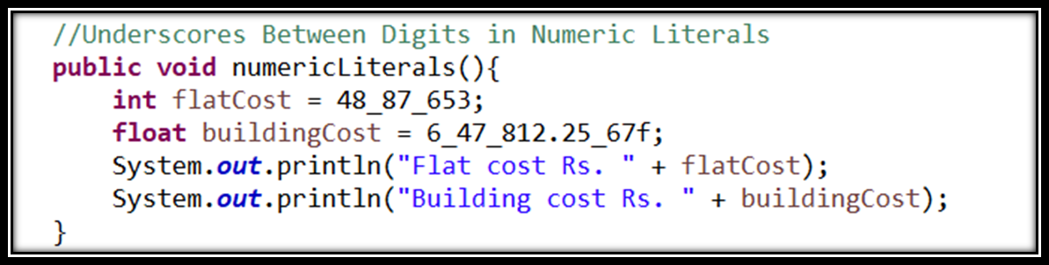
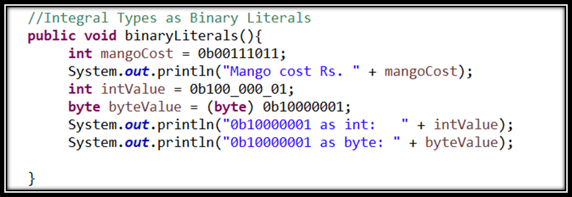
Underscores in Numeric Literals

Slide 15
Diamond Operator
JDK versions prior to 7.0 required declaring the types on both sides while declaring a variable using Generics.
Map<String, List<Sale>> sales= new TreeMap<String, List<Sale>> ();
In Java 7.0, you can write the above line of code like this,
Map<String, List<Sale>> sales= new TreeMap<> ();
You don’t have to type the whole list of Types in the right side for instantiation, instead you can use <> symbol, which is called diamond operator.

Slide 16
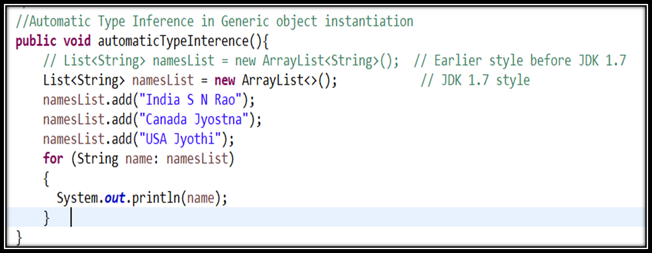
Diamond Operator

